Slide 1

Programming Principles IT-5014
Junaidh@whitecliffe.ac.nz

Slide 2
Programming Fundamentals
What is programming?
Why we do it?
What can we achieve?
How can we do it?
Principles, Guidelines, Practices
Programming
Writing a set of instructions to tell a computer how to perform a particular task.
Program
A sequence of steps or instructions defined for a computer to perform a particular task.
Junaidh@whitecliffe.ac.nz
Notes:
1- Instructions for a computer
2- To perform specific task(s) by communicating with computers
3- Solve real-time problems, e.g., Desktop applications, Web applications, Mobile applications and many more …
4- By learning programming languages C, C#, PHP, Java, Python
Programming is all about learning computer language(s) to write instructions for the computers to perform specific task(s) to solve real-time problems.
5- Software development Life Cycle.

Slide 3
Skills
Example: Find the maximum and minimum numbers from the list below.
List = [1, 2, 9, 51, 68, 78, 45, 91, 100, 99]
Follow a process
Analysis
Critical thinking
Testing
Junaidh@whitecliffe.ac.nz

Slide 4
Programming Languages
Low-Level: Write code in the form of instruction requiring little or no translation for the machine to understand.
First Generation Language (Machine code, Binary representation)
Second Generation Language (Assembly language, Executable machine Code)
High-Level: Write code with many natural language elements.
Execution modes (Compiled, Interpreted and Hybrid)
Your thoughts?
Easy/Hard?
Slow/Faster?
Junaidh@whitecliffe.ac.nz

Slide 5

Programming Languages
Your thoughts?
Machine Code
Machine Code -> Executable
Source code -> Machine code -> Executable
Interpretable source code -> Executable
Junaidh@whitecliffe.ac.nz

Slide 6
Flow Charts
A diagram (graphical representation) that illustrates steps that a computer needs to perform to complete a task or solve a problem.
Roadmap from Start ->End
Why we need flow charts in writing programs?
Example: Write a code where a user will provide three inputs from the numbers in the range of 1-100. The program should calculate the average of those numbers. The program should send four outputs to the user as which input number is the smallest, largest, average of three numbers entered and print successful when average is more than 50.
Junaidh@whitecliffe.ac.nz

Slide 7
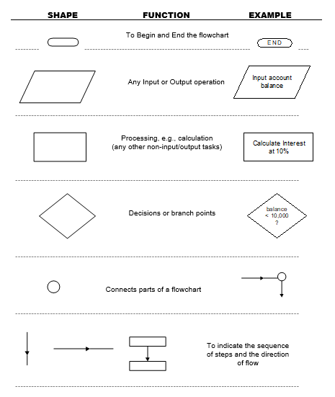
Flow Charts Symbols
Junaidh@whitecliffe.ac.nz

Slide 8
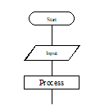
Flow Charts: Sequence
A sequence is defined as flow lines connecting the shapes.
“START” sign and follow the flow-line until you reach a shape with an instruction in it.
The flow-lines are normally followed from top to bottom and from left to right. However, if arrows are included on a flow-line, then the flow-line is followed in the direction of the arrow.
Junaidh@whitecliffe.ac.nz

Slide 9
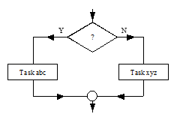
Flow Charts: Condition
A condition is represented by the diamond shape with two paths leaving it. The decision in the diamond has a Yes/No answer, and the corresponding flow-line is followed depending on the answer to the question.
Junaidh@whitecliffe.ac.nz

Slide 10
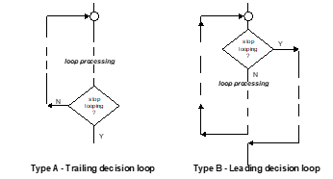
Flow Charts: Iteration
An iteration is represented by a decision diamond that has one of the exit paths returning to a point higher in the flowchart. This return path is called a loop. The question inside the diamond is called the loop control condition. There are two main types of flowchart iteration loops, which for convenience will be referred to as TYPE A and TYPE B.
Junaidh@whitecliffe.ac.nz

Slide 11
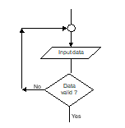
Flow Charts: Iteration
Type A: This always executes the statements in the loop at least once. This is because the loop control condition is evaluated at the end of the loop, and the instructions in the body of the loop will have already been executed before then. It corresponds to the pseudocode form Repeat … Until. It can be referred to as a Trailing Decision Loop.
Example: Suppose at a particular point in a program, a user has to enter a data value, and the processing cannot proceed until a valid entry is made.
Junaidh@whitecliffe.ac.nz

Slide 12
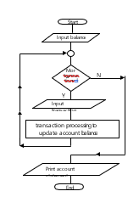
Flow Charts: Iteration
Type B: This may not execute the loop instructions even once. This is because the loop control condition comes before the execution of the loop instructions, and a false result at the beginning would mean that the body of the loop is bypassed. This type corresponds to the pseudocode form While. It can be referred to as a Leading Decision Loop.
Example: Suppose a banking program has to print a statement for a savings account. To do this, it has to input an opening balance, and then process any transactions (deposits or withdrawals) made against the account over the period that the statement covers.
Junaidh@whitecliffe.ac.nz

Slide 13
Flow Charts: Example
Suppose you had a brief where you had to create an algorithm to update account balances,
entered from the keyboard, with an interest payment calculated at a rate of 8% per annum for
balances less than 10,000, and at a rate of 10% for 10,000 or more. Print the account statement.
You need to allow for accounts to be processed until no longer exist.
Junaidh@whitecliffe.ac.nz

Slide 14
Flow Charts: Solution
Input account balance from the keyboard.
If account balance is less than 10,000, use 8% per annum rate; otherwise, 10%pa rate.
Calculate interest using appropriate interest rate.
Add interest amount to current balance.
Print account statement.
Repeat steps 1 to 5 while there are more accounts to be processed.
Junaidh@whitecliffe.ac.nz

Slide 15
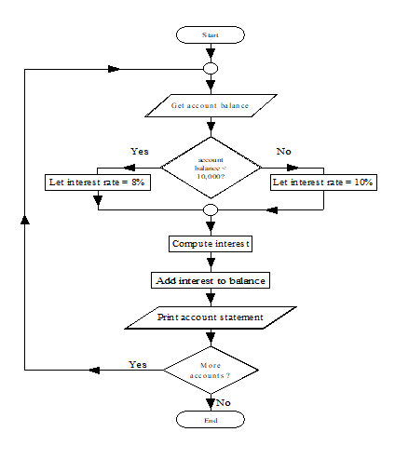
Flow Charts: Solution
Junaidh@whitecliffe.ac.nz

Slide 16
Any Question(s)?
Junaidh@whitecliffe.ac.nz

Slide 17
IT5014 Programming Principles learn.mywhitecliffe.com
Junaidh@whitecliffe.ac.nz

